Slide 1
Growth of Function
Asymptotic Notations

Slide 2
Introduction
The order of growth of the running time of an algorithm, deﬁned for Insertion Sort, gives a simple characterization of the algorithm’s efﬁciency and also allows us to compare the relative performance of alternative algorithms.

Slide 3
Introduction Contd..
Once the input size n becomes large enough, merge sort, with its ϴ(n lg n) worst case running time, beats insertion sort, whose running time is ϴ(n²).
When we look at input sizes large enough to make only the order of growth of the running time relevant, we need to study asymptotic efficiency of algorithms.

Slide 4
Asymptotic Notations
The notations we use to describe the asymptotic running time of an algorithm are deﬁned in terms of functions whose domains are the set of natural numbers N = {0, 1, 2, ...}
Such notations are convenient for describing the worst-case running-time function T(n), which usually is deﬁned only on integer input sizes.

Slide 5
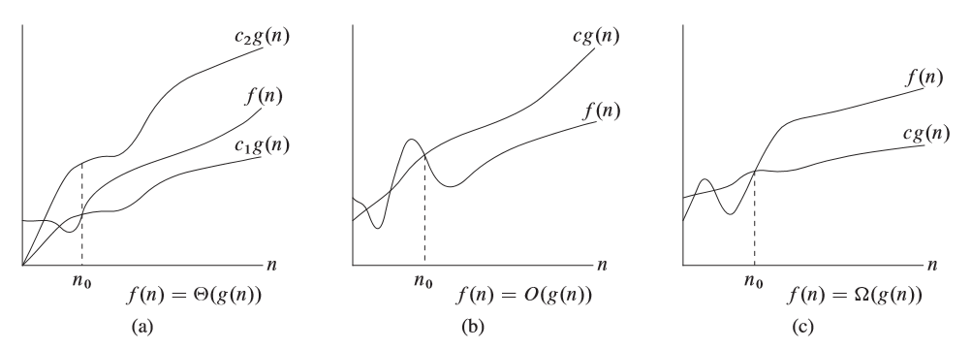
Graphical Representation
1
2
3

Slide 6
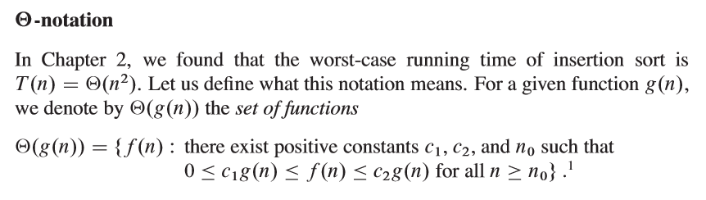
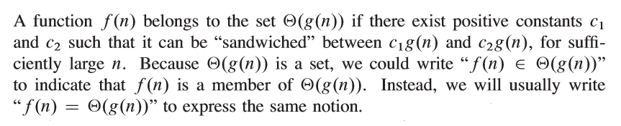
Notations
So, g(n) is an asymptotically tight bound for f(n).

Slide 7
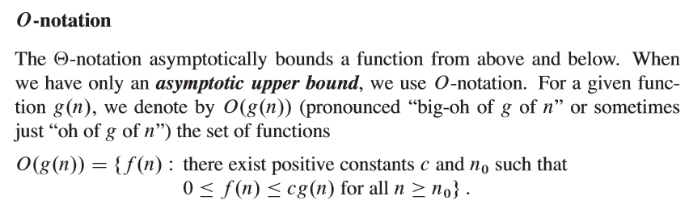

Notations

Slide 8
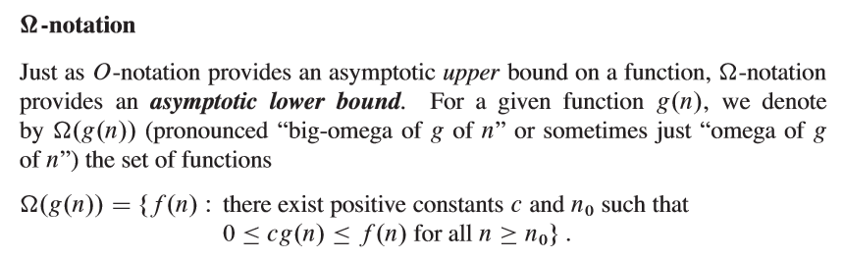
Notations

